Slide 1







Scratchpads
Virtual Research Environments
for taxonomic and biodiversity related data
Dr Dimitrios Koureas
Department of Life Sciences | Biodiversity Informatics Group
The Natural History Museum London
Notes:
1.

Slide 2

Where to find and how to cite this presentation
Scratchpads introductory presentation. Dimitrios Koureas, Laurence Livermore. figshare. 2013. doi:10.6084/m9.figshare.640101

Slide 3
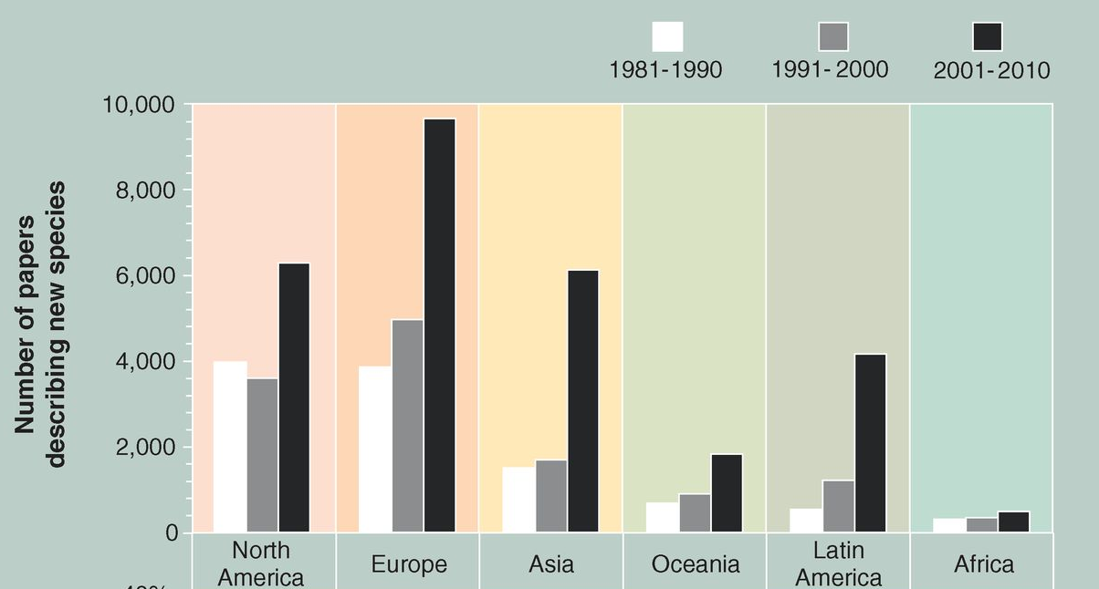
Current taxonomic data production
Typically generated by
small communities
for “local” research projects
Publications based on countless
specimens, images, maps, keys and datasets
Figure from Costello M.J et al, 2013. doi: 10.1126/science.1230318
Notes:
With almost 2 million species already described, the taxonomic data production is ever increasing. The rate of increase is significantly higher in small research communities all over the world. The graph depicts the publications on new species to science. These publications are usually a
Our larger taxonomic community produces more data than ever before. Almost 20k new taxa are described annually. While 30k nomenclatural acts are published. All these usually based on countless specimens, images maps keys and datasets that most of the times remain unpublished. Typically all this taxonomic outcome is generated by small communities during local or regional research projects.

Slide 4
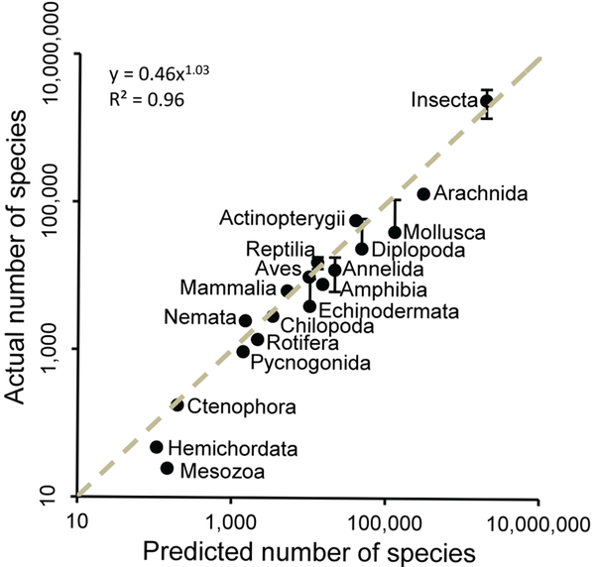
On the other hand:
Estimates of
7.5 million species
still undescribed¹
¹How Many Species Are There on Earth and in the Ocean? Mora C et al.
doi:10.1371/journal.pbio.1001127
Notes:
With almost 8 million species still to be described,

Slide 5
Expected volume
of taxonomic and biodiversity data
Need of extracting, aggregating and linking data on a global level

Slide 6
The four nodes of data cycle
1. We collect and generate data
2. We curate, link and structure data
3. We analyse data
4. We publish data
Notes:
So as the amount of available research data increase year by year, efficient mobilisation of this data can be considered equally if not of higher importance.
If we were to set the critical steps in mobilising data we would probably come up with a scheme like this
1.
2.
3.
4.

Slide 7
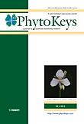

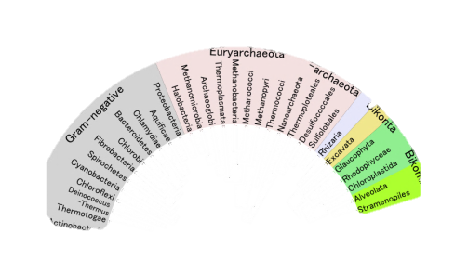
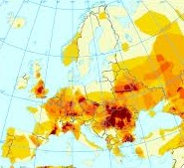
The four nodes of data cycle
What are the
bottlenecks
in the workflow?
Data
collection &
generation
Data
publishing
Data
curation
Data
analysis
Notes:
To efficiently connect these nodes we need the right tools. If we were to point out the bottleneck in the entire data flow process we would probably identify problems in
1.
Structuring and formatting of data in a way that is meaningful to our own further research as well discoverable and usable to the rest of the research community.
2.
The second bottleneck in the flow is usually found in the data publishing process. The amount of information and knowledge generated by the research community is usually much more than what someone can find in published works. We all seat upon an all increasing amount of meaningful data that never get published.

Slide 8

What we need is…
a
seamless
workflow
Data
collection &
generation
Data
publishing
Data
curation
Data
analysis
Notes:
So eventually what we need is to eliminate these two bottlenecks in the process. We need a seamless data workflow that will allow to make a better use of all available datasets and also allow researchers to take credit for all their research volume.

Slide 9
To achieve this…
“Link together evolutionary data… by developing analytical tools and proper documentation and then use this framework to conduct comparative analyses, studies of evolutionary process and biodiversity analyses”
This requires data, information & knowledge to be…
  Digital
  Not printed paper
  Openly accessible
    Not behind barriers (e.g. paywalls)
  Linked-up
    Not in silos
Cyndy Parr, Rob Guralnick, Nico Cellinese and Rod Page. TREE. doi:10.1016/j.tree.2011.11.001
Notes:
9
The Big Question… How do we achieve this ???
Cidy Parr et al set the the frame under which the great informatics challenge of our times should be addressed. Link together….. But to reach this we need:
Data, information and knowledge to be
Digital, openly accessible and linked-up
In other words we need a open global systematics approach

Slide 10
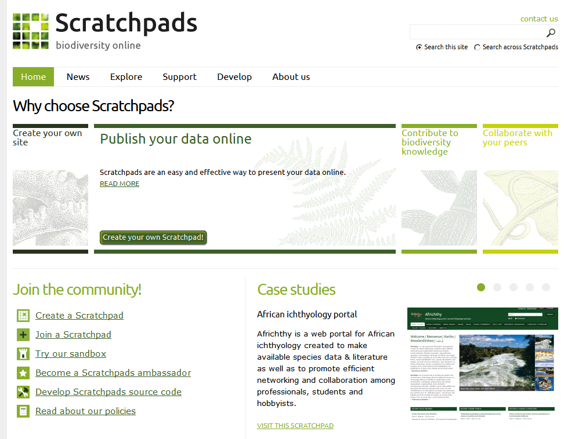
Scratchpads
Virtual Research Environments
Making taxonomy digital, open & linked
Notes:
The Scratchpads platform is being developed for the last 5 years under this framework. To provide researchers with the necessary tools to make taxonomy digital, open and linked!
To facilitate the development of virtual research environments
10

Slide 11
so…
what are
the
Scratchpads?

Slide 12
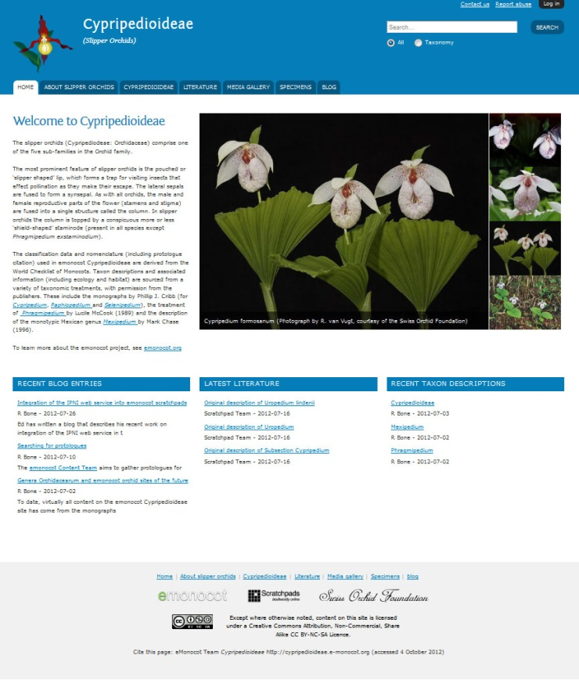
What are Scratchpads?
Hosted websites for biodiversity data
Virtual research & publication platform
Completely open access & open source
Modular & flexible
Notes:
What are Scratchpads? They are hosted websites for biodiversity data, but the specifics and the kind of data are entirely up to the user.
Scratchpads are designed to be a virtual research and publication platform, a place where you should be able to store, save, publish and reuse your work.
They are completely open access, open source and free to use.
They are modular and flexible. It is possible for other developers to work with us to write modules for specific functions or communities.

Slide 13
What are Scratchpads?
facilitate
development of online research communities
through
standardized environment of entering and curating data
that allow
sharing and interlinking
and
dissemination of research products

Slide 14


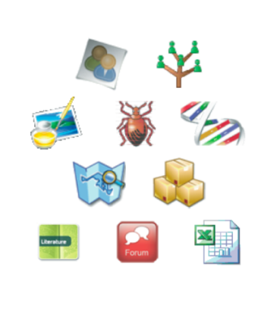






The Scratchpads concept
A Scratchpad is a website that holds data for you and your community
Your data
External data & services
Notes:
Scratchpads are fed by your data. Scratchpads help you structure your data in a way that makes them both human and machine readable. Allows you to contribute to global biodiversity databases and also aggregates all related to your data information from external resources.

Slide 15
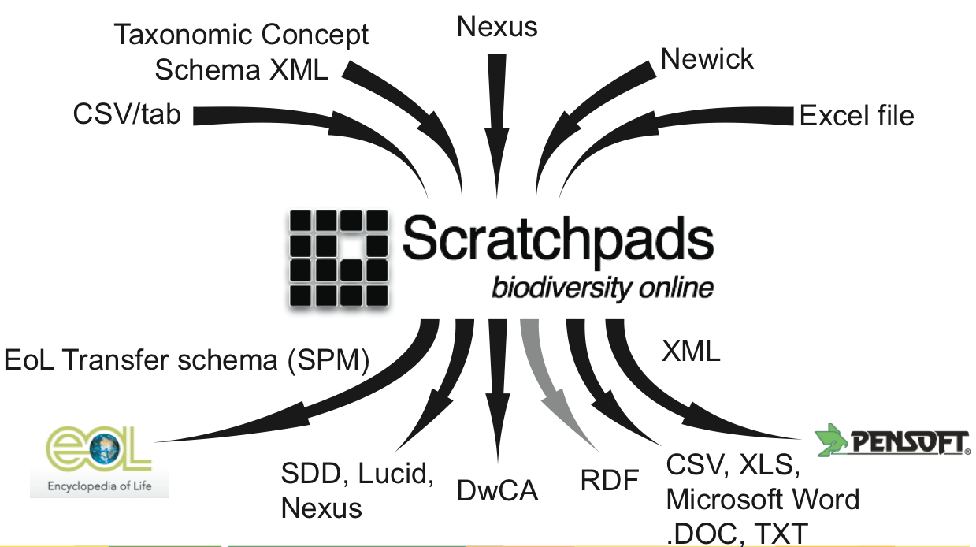
The Scratchpads concept

Slide 16
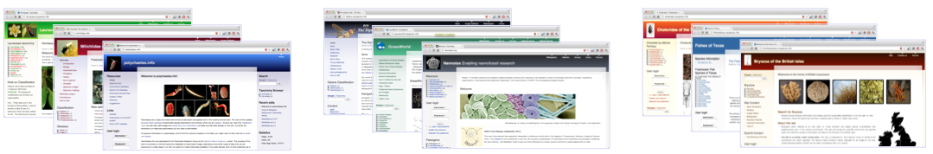
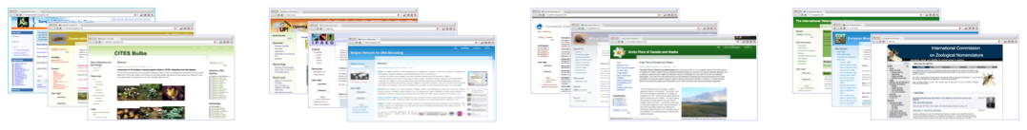
Examples of use:
Taxa
(Classifications, taxon profiles, specimens, literature, images, maps, phenotypic, genotypic & morphometric datasets, keys, phylogenies)
Conservation
Projects
Regions
Societies
Notes:
Most Scratchpads are used primarily for describing taxa and are based around biological classifications. They contain a mixture of data, such as taxon descriptions, specimen records, literature, images, distribution maps, character datasets, keys and phylogenies.
Other Scratchpads do not focus primarily on specific taxonomic groups and can cover conservation, projects (like PhD studies), whole regions (multiple taxonomic groups) or societies (where the focus is on users and communicating with them).
The modular nature of Scratchpads means you can do all this in one site, although typically a site will focus on only a few of these activities.

Slide 17
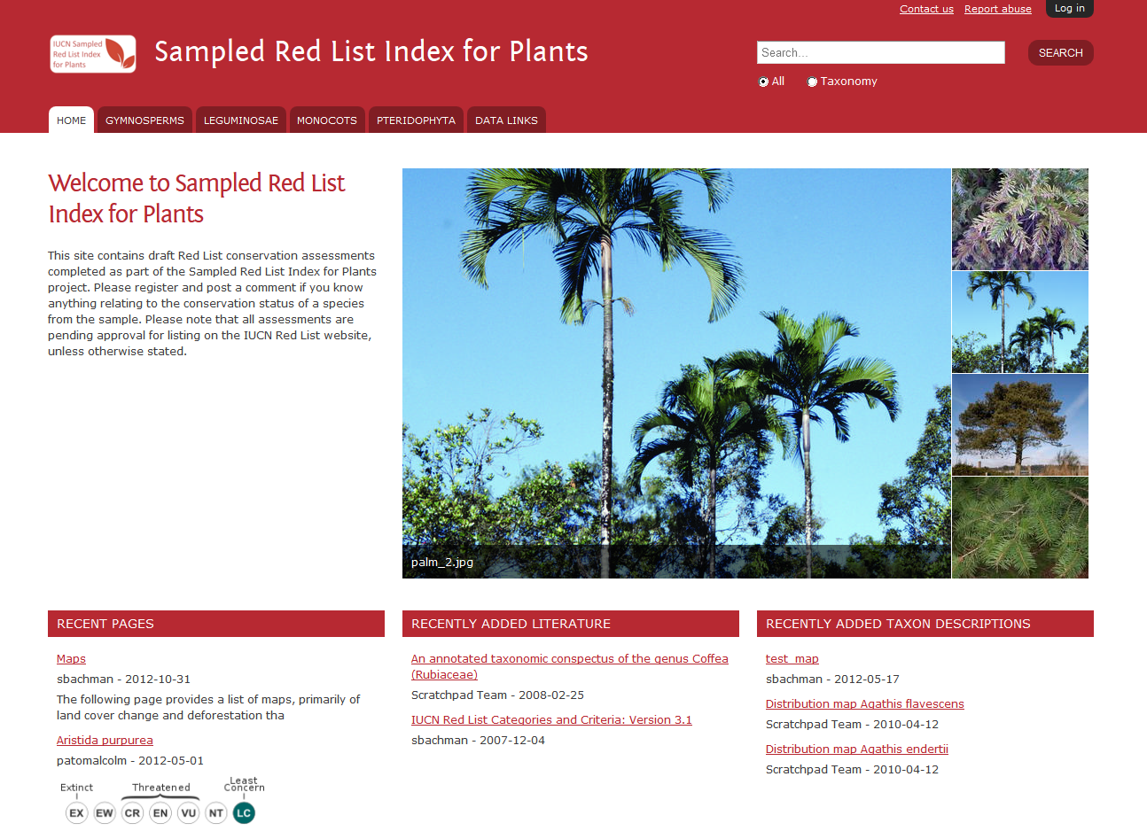
Examples of use:
Red List conservation assessments

Slide 18
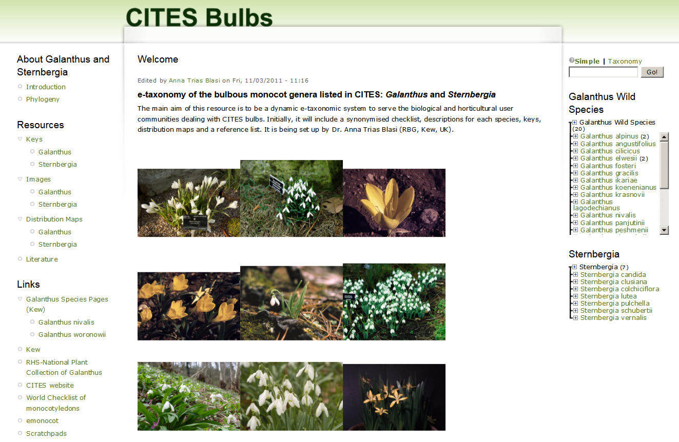
Examples of use:
Bulbous monocot genera listed in CITES

Slide 19
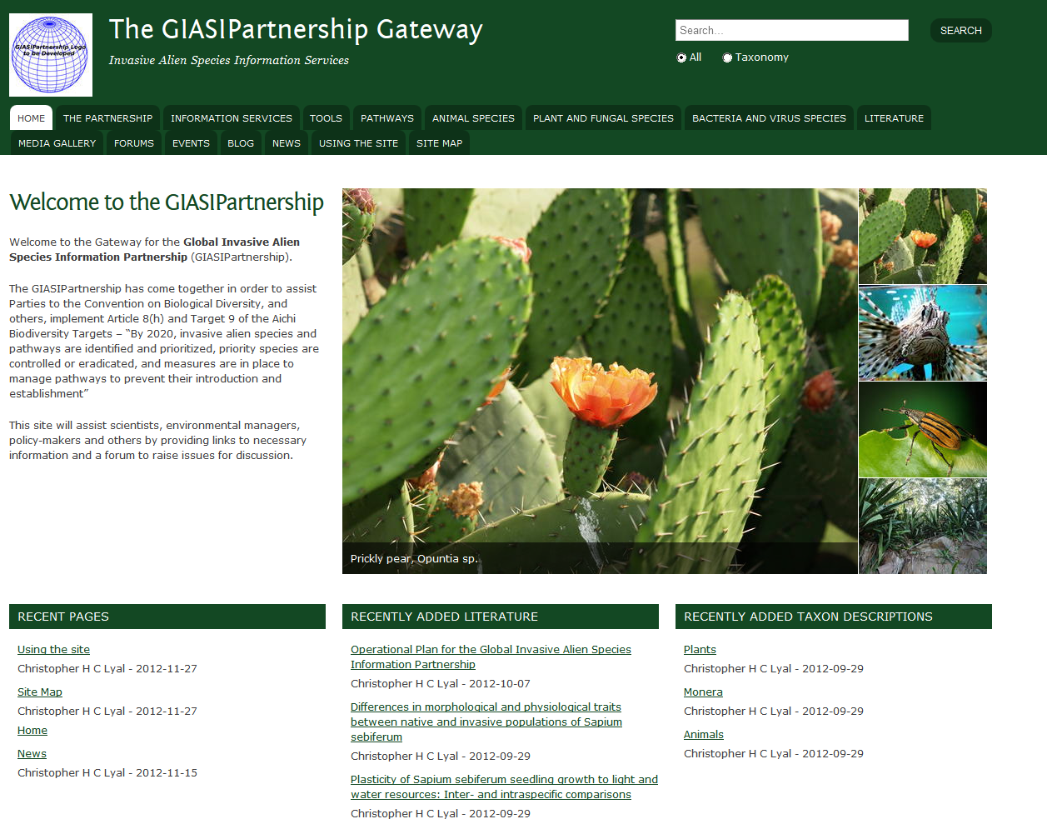
Examples of use:
Global Invasive Alien Species Information Partnership

Slide 20
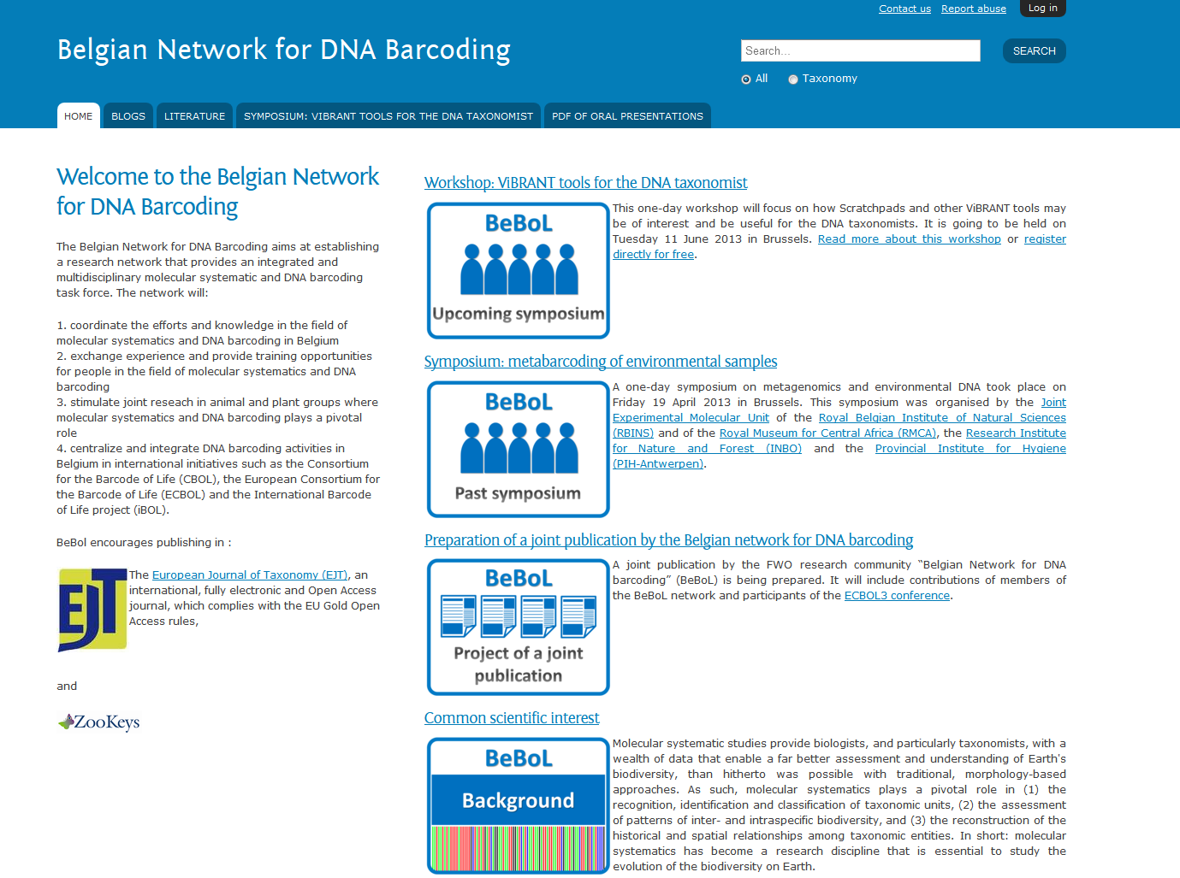
Examples of use:
Belgian Network for DNA Barcoding

Slide 21

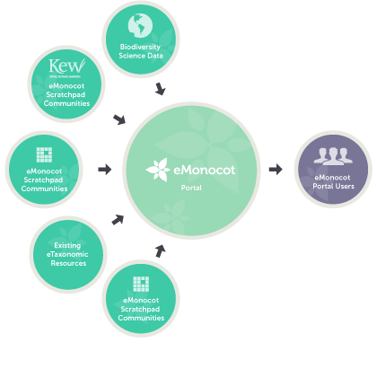
Major integrated projects
Online resource for monocot plants
Collaboration between Kew, Oxford University and NHM
Data to be open and usable by other scientists
Notes:
The aim of eMonocot is to produce a web-based treatment of monocot plants by linking together monocot taxonomists by providing support and tools to enable communities to manage their taxonomic data online.
The project is a collaboration between RBG Kew, responsible for generating and digitising existing content, Oxford University, for creating a data portal, and The Natural History Museum, for developing additional botanical support in Scratchpads and running the outreach program.
The resulting data in eMonocot will be delivered to a large audience of biodiversity and environmental scientists through a portal, although the information will be accessible to everyone.

Slide 22
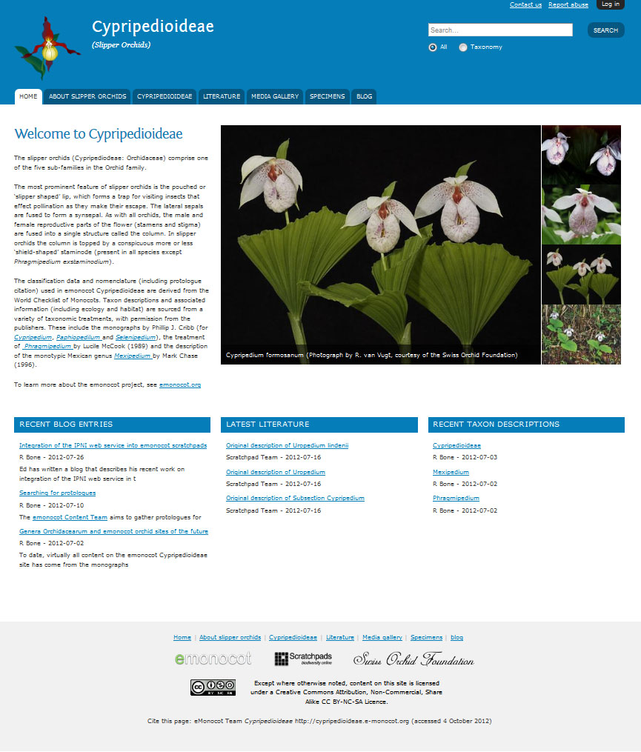
Major integrated projects
21+ open community sites and growing
Over 45 internationally collaborating scientists
Site data feeds into a “Portal”
Site List: http://about.e-monocot.org/list-emonocot-scratchpads
Notes:
In the project there are more than 21 eMonocot Scratchpads which have over 45 international collaborating scientists.
The eMonocot Scratchpads cover over 15 families with more planned with additional workshops which will take place this year at Monocots V in New York.
The Scratchpad to eMonocot Portal link is now active and available for the public to browse all the Scratchpad data combined with other external monocot resources.

Slide 23
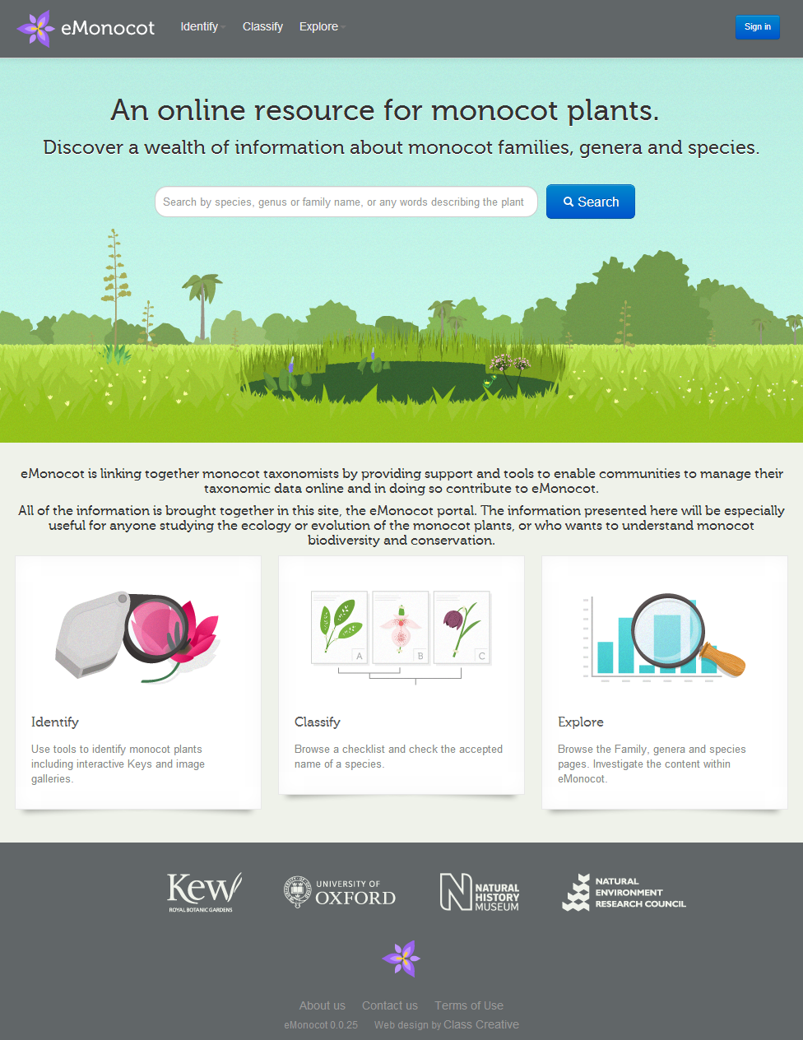
Major integrated projects
Retrieve information on any Monocot plant
Rich downloadable data
Identification keys
Model example of linked attributed data
eMonocot Portal: http://e-monocot.org/
Notes:
All of the information is brought together in the eMonocot portal. The information presented here will be especially useful for anyone studying the ecology or evolution of the monocot plants, or who wants to understand monocot biodiversity and conservation.
The portal provides taxon descriptions, distribution maps, taxonomies and keys, all of which are downloadable and attributed to the author and contributing site.

Slide 24
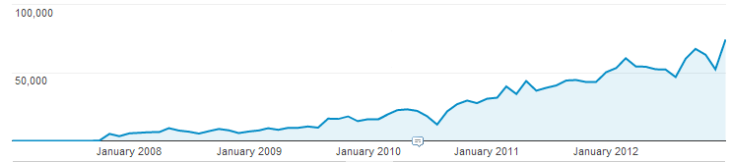
Are Scratchpads sustainable?
512 Scratchpads Communities
by 6,500 active registered users
covering 73,444 taxa
in 515,189 pages.
In total more than 1,300,000 visitors
Per month unique visitors to Scratchpads sites
65,000
unique visitors/month
Notes:
Are scratchpads a sustainable platform in the long term?
Usually to answer this question you need to ask yourself: Is the tool expanding its user base? And has adequate funding for the future?
Are scratchpads currently used as a tool by the biodiversity research domain community? The statistics support they are!
With more than 450 individual research communities by almost 6500 active users holding taxon descriptions for more than 52000 taxa in almost half a million pages.

Slide 25

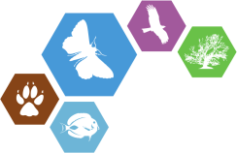


Are Scratchpads sustainable?
2007
2011
2014
ViBRANT
Virtual Biodiversity Research
&
&
Other grants in the pipeline
Proposals?
Notes:
For the second question:
Scratchpads are currently funded through the ViBRANT and e-monocot projects. And from 2014 will structurally integrated in the biodiversity informatics initiative of the Natural History Museum London. Full time staff dedicated for the project in the long term.

Slide 26
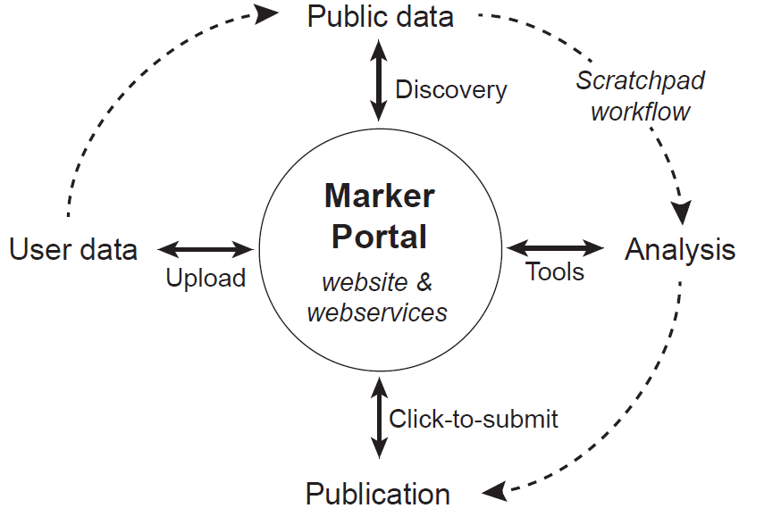
Are Scratchpads sustainable?
Marker Portal
a project in the making
Unified, comprehensive access to public marker data across the tree of life
Mine genome and other submitted data for MLST targets in addition to the data submitted explicitly as MLST
Support for bioprospecting and biomonitoring

Slide 27
the main
features

Slide 28
The main features
Classification term
oriented system
Biological
classifications
Non-biological
classifications
Taxonomies
Hierarchical controlled
vocabularies

Slide 29
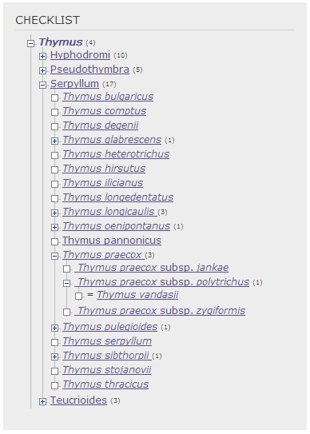



The main features
Dynamic Biological Classifications
Manually entered or imported
Auto generated
Notes:
Scratchpads are built upon taxonomies. Biological classifications are the backbone of every scratchpad structure linking all the content together.
These classifications can be as extensive as the user needs them.

Slide 30
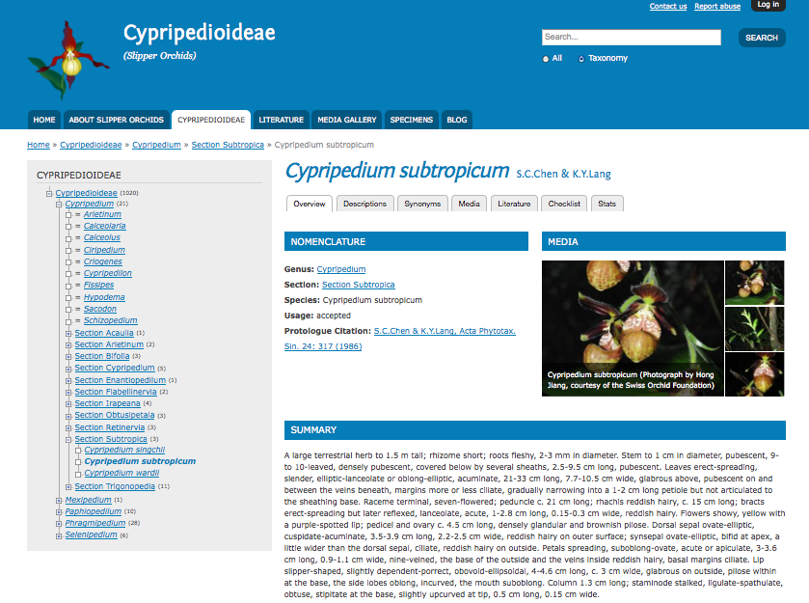
The main features
Taxon pages
Overview of data related to taxon
Generated from tagged content
Notes:
Intuitive professional looking layout.
Easy to compile taxon pages without any knowledge of web design.
Taxonomy provides the crucial backbone, linking content together and is easily updateable.
On this page you can see the classification browser in the side bar, detailed nomenclatural information, images and a diagnostic summary.
30

Slide 31
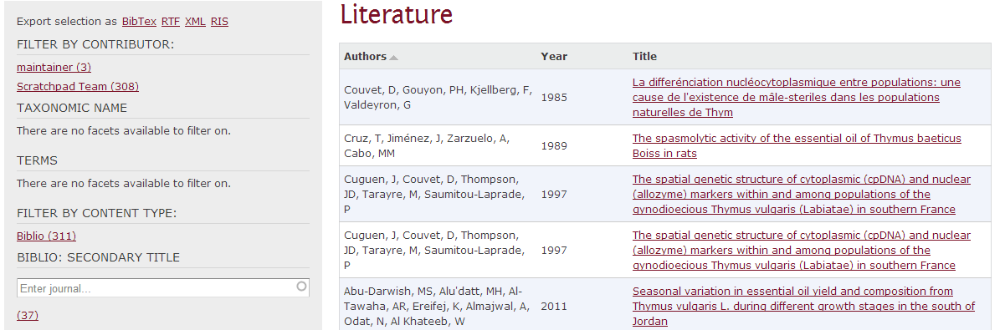
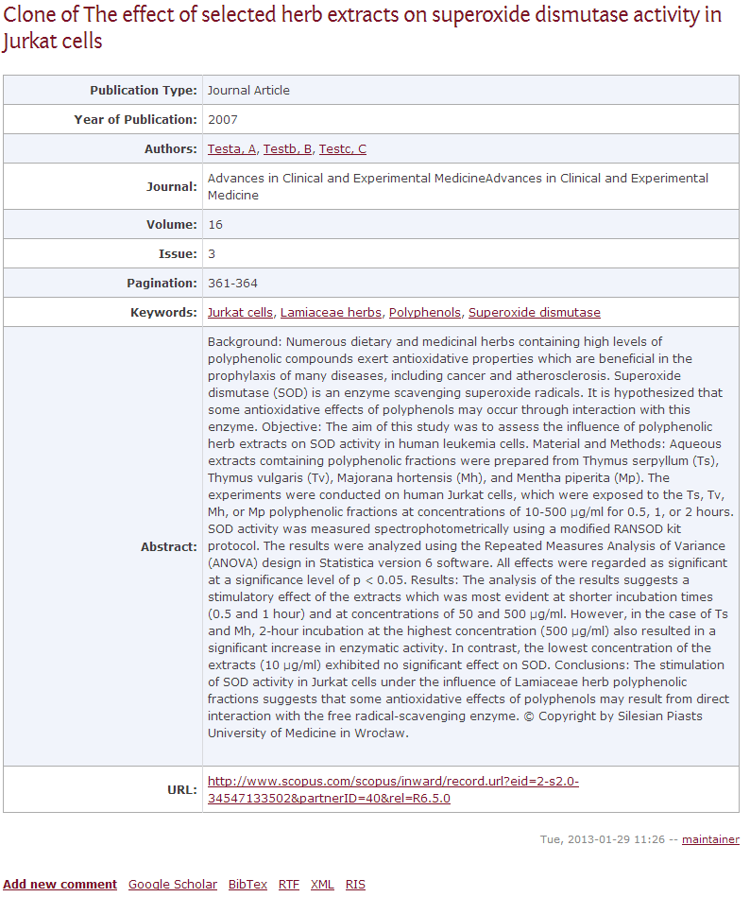

The main features
Bibliography management
An inbuilt Bibliography manager
Faceted browsing
Taxon tagging and free keywords
Import from and export to all major formats

Slide 32
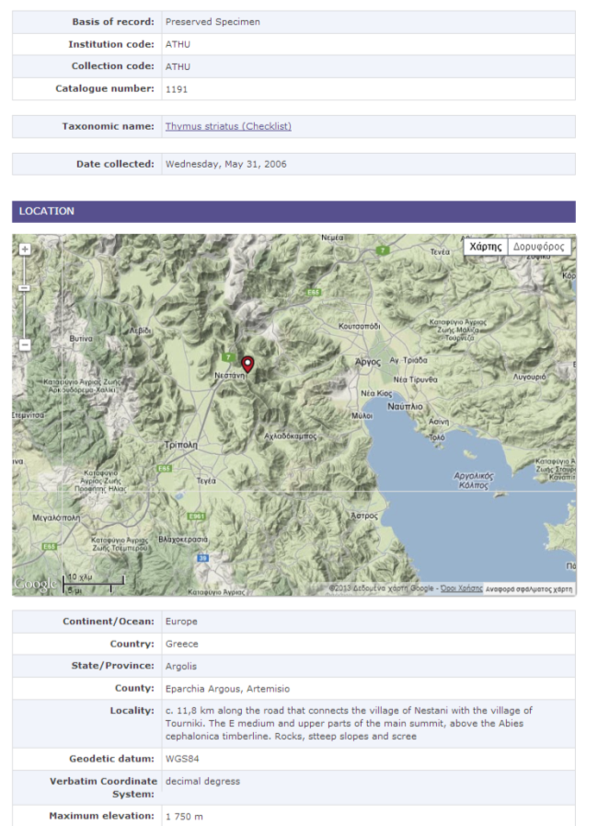
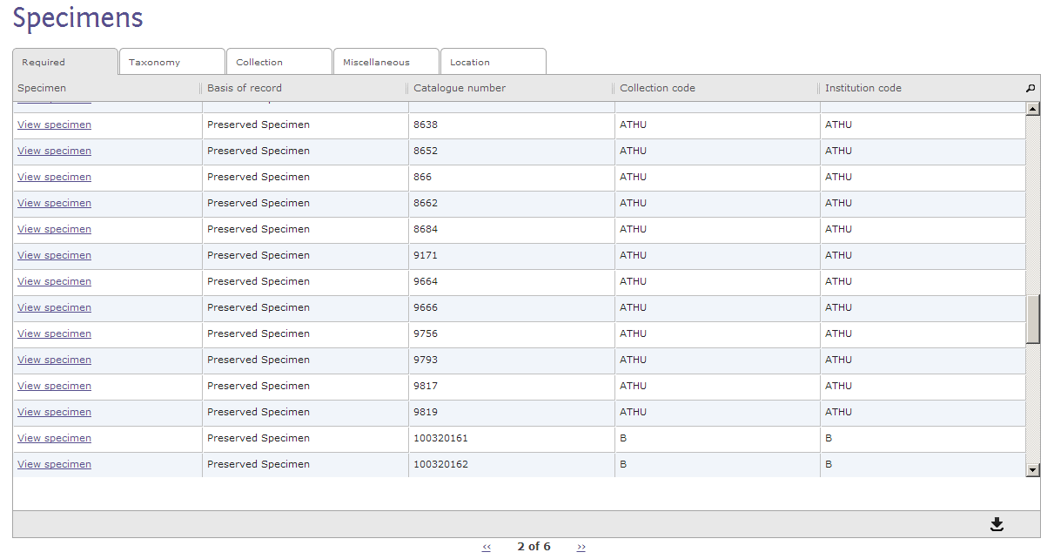
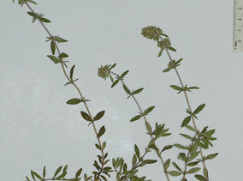
The main features
Specimen/Observation data
Annotated full specimen/observation records
Linked to images and georeferenced
Linked to GenBank accession numbers

Slide 33
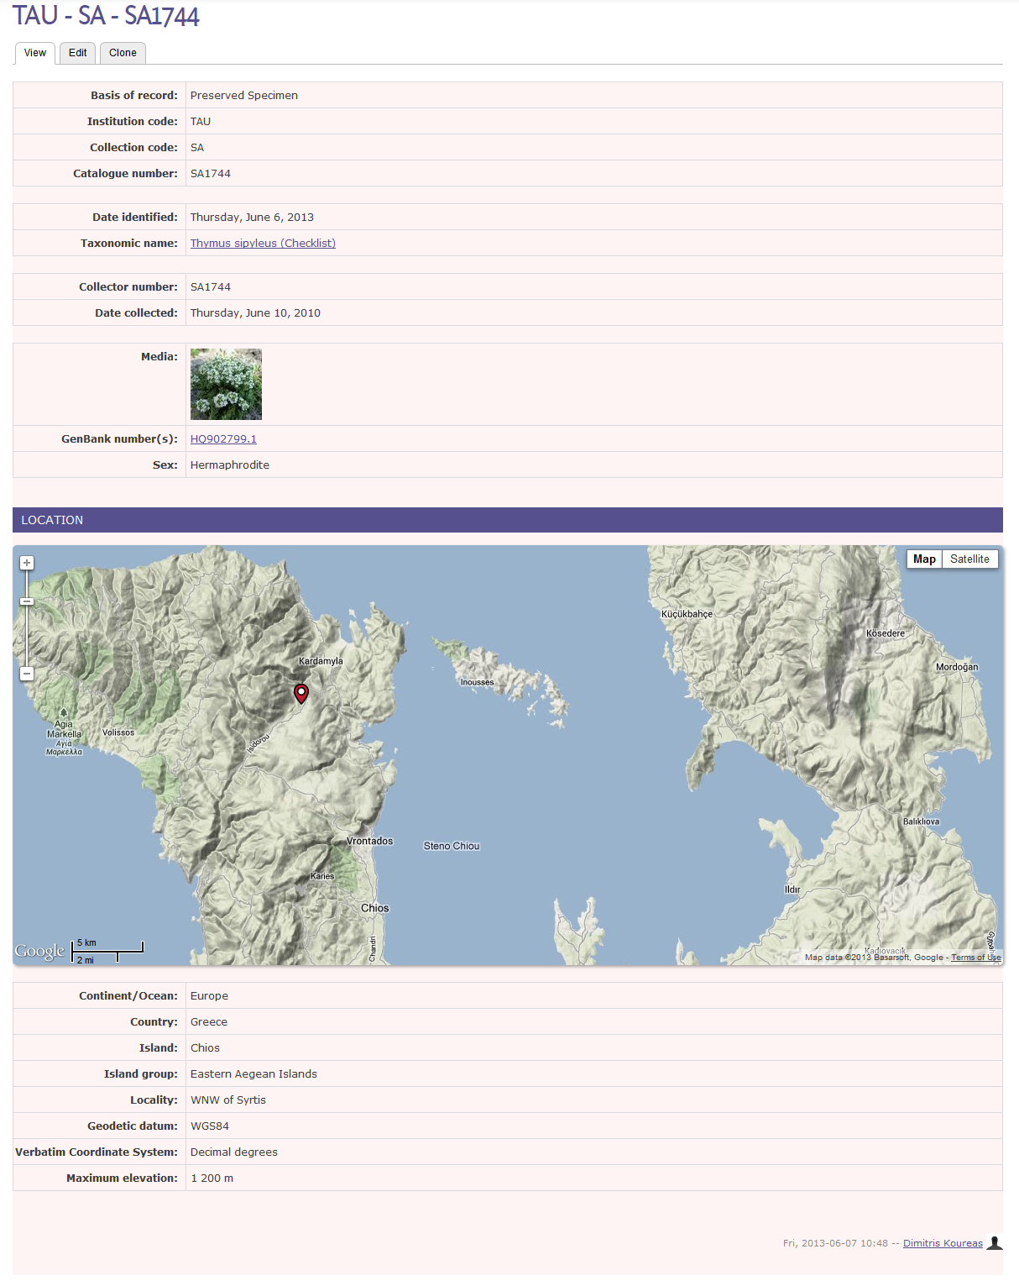

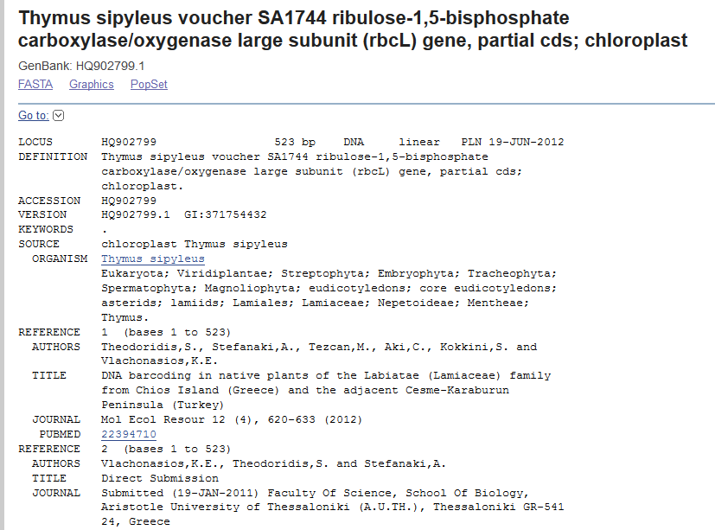

Slide 34
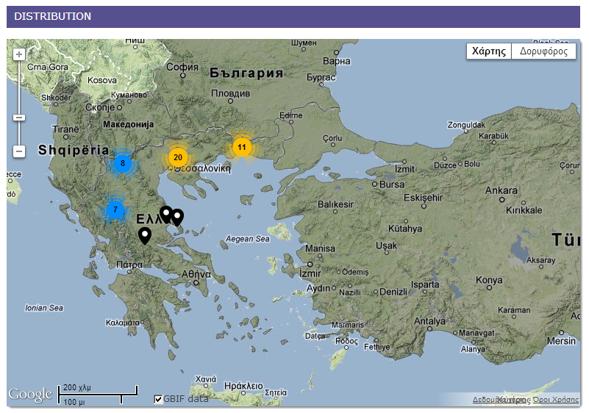
The main features
Distribution maps
Google maps based
Data layers
Occurrence data
Distribution data
TDWG regions
GBIF data

Slide 35
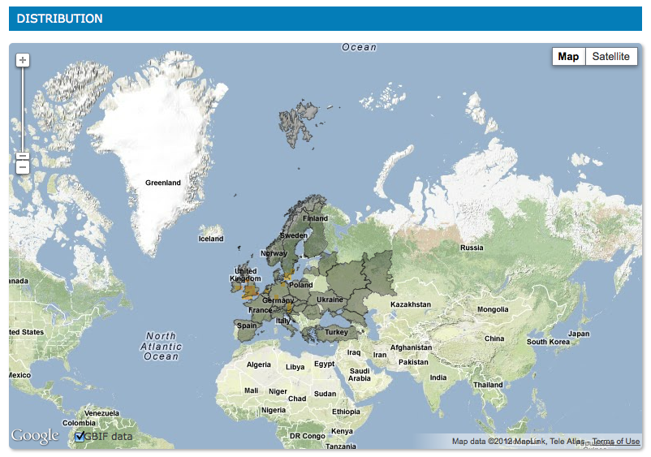
Example regional distribution
The main features

Slide 36
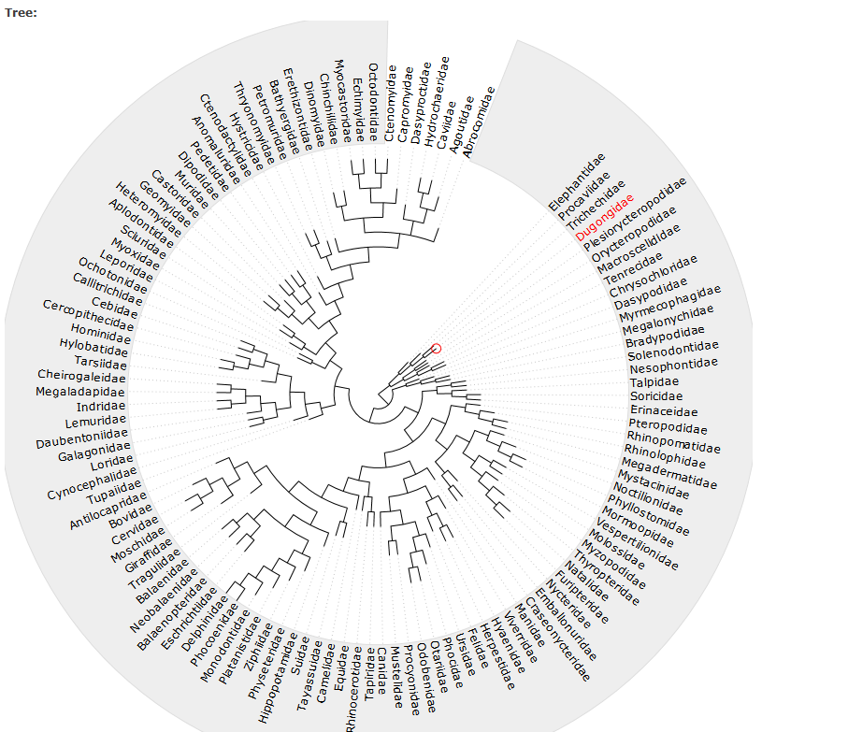
Create phylogenetic trees
Based on Newick/NeXML
Different views

Slide 37
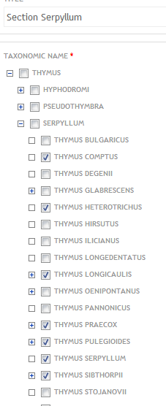
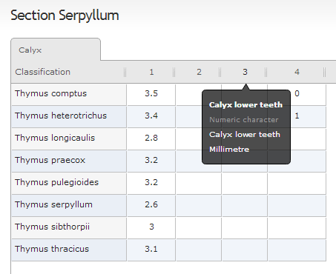
The main features
Character matrices – Key construction
Quantitative or qualitative characters
Auto generation of keys
Taxon based matrices
[Specimens based character matrices]

Slide 38
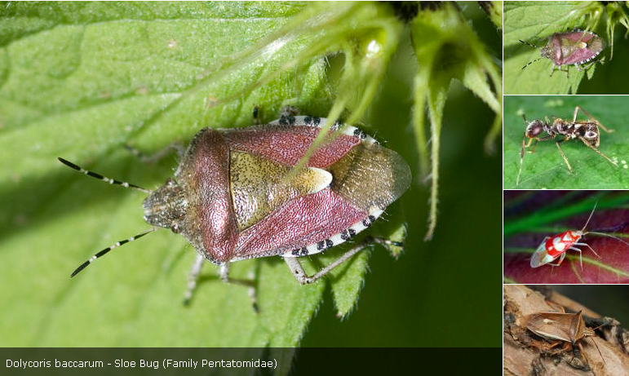
The main features
Media handling
Bulk upload
Metadata
(EXIF & Audobon core)
Media galleries

Slide 39
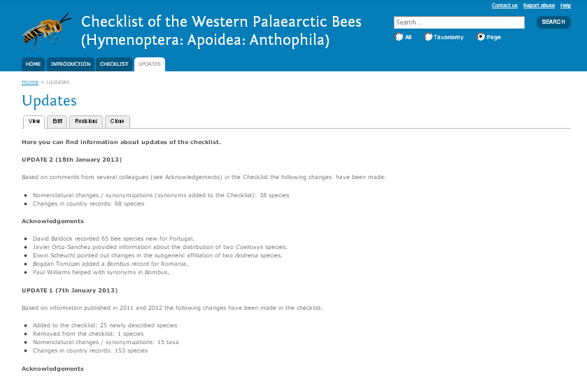
The main features
Generation of custom pages
Tagged or not
External RSS
Twitter feeds
Media files

Slide 40
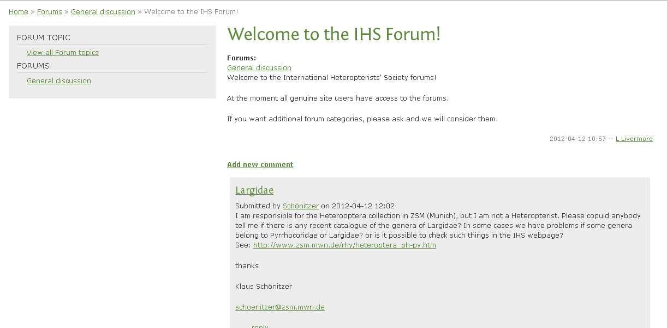
The main features
Enhanced communication tools
Working groups
Forums
Blog entries
Webforms
Newsletters
RSS syndication
Inbuilt comments

Slide 41
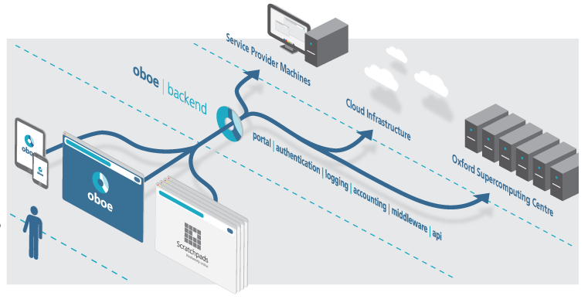
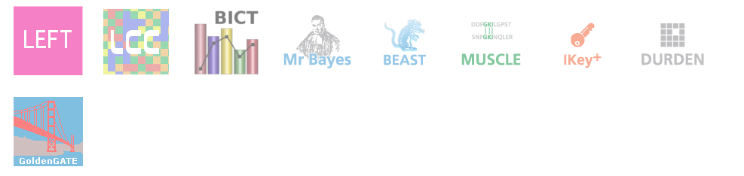
The main features
analytical
tools
OBOE service
i.a.
Ecological informatics,
Phylogenetics,
Sequence alignment
Notes:
You can use Scratchpads to analyse your imported data through the OBOE backbone service.

Slide 42




Phylogenies
MCMC methods to estimate the posterior distribution of model parameters
Sequence alignment
Multiple sequence alignment
Microsatellite repeats finder

Slide 43




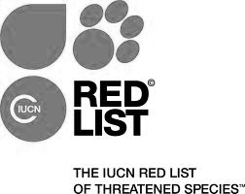




External services Integration
data
mobilisation
more on the way…

Slide 44
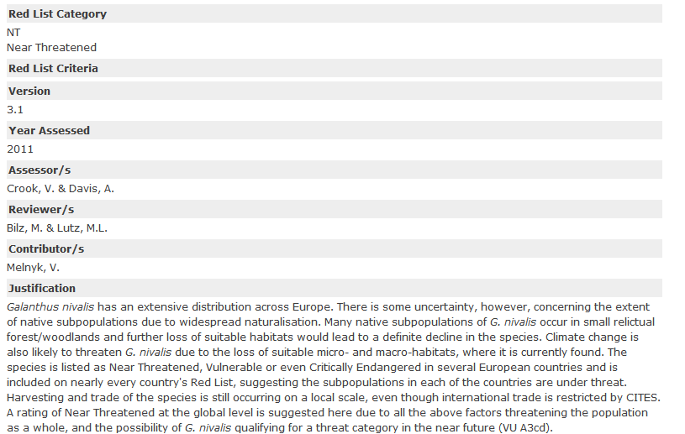
IUCN data integration

Slide 45
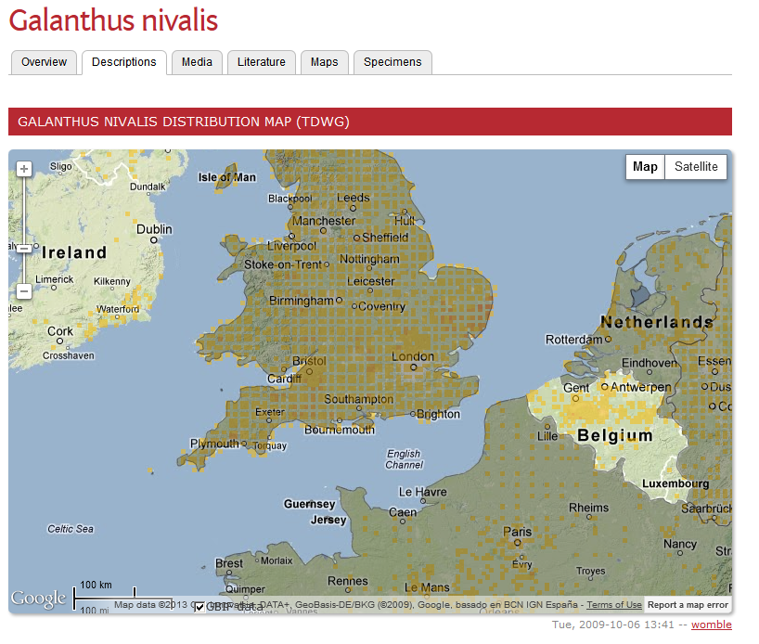
GBIF data integration

Slide 46
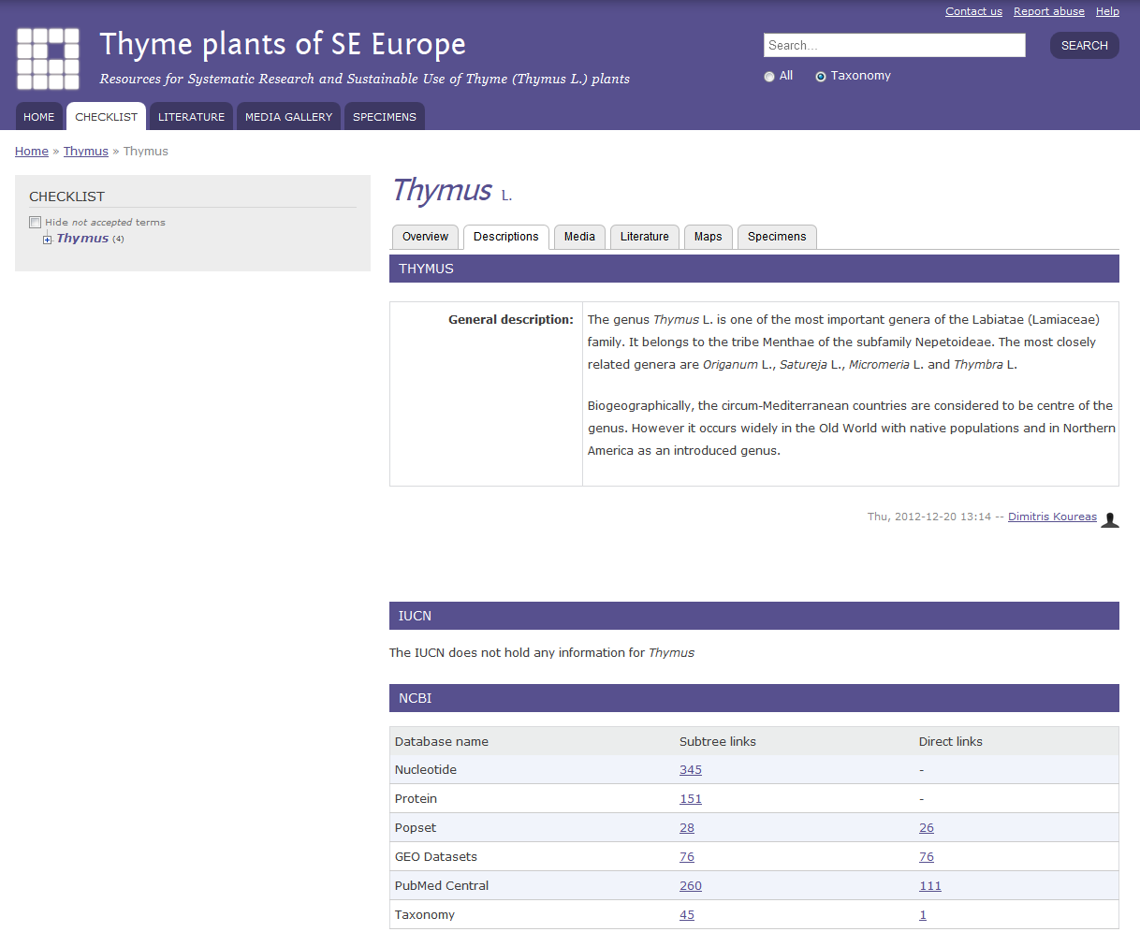

Slide 47
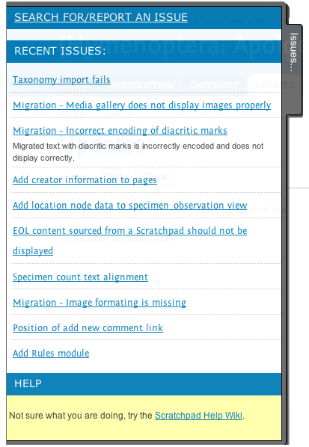
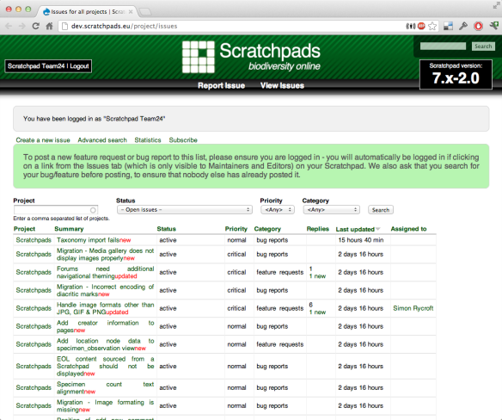
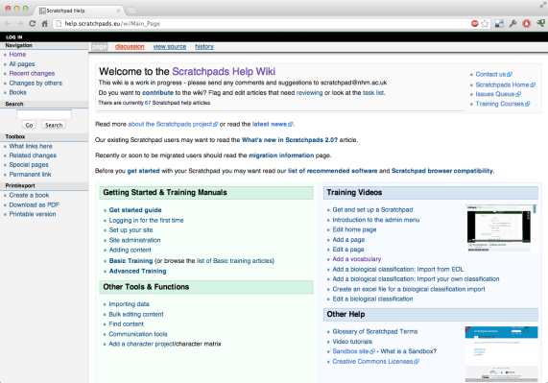
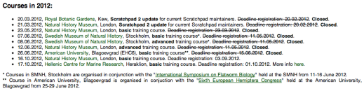
Help & Support
In-site Support
Wiki
Training Courses (12 in 2012)
Ambassadors Programme
Embedded Issues Queue
Sandbox Site
http://help.scratchpads.eu
Notes:
We have a number of help and support systems built into Scratchpads.
Many of the Scratchpad editing screens have inbuilt help and for more comprehensive information, including training manuals, users can visit our help wiki.
We regularly run Scratchpad training courses and will have given 12 courses in three continents this year.
We are actively developing an ambassadors programme for our experienced users that will let them get involved in the early testing of new features and small grants or support to run training courses in their country.
The embedded issues queue makes it easy for users to submit help and issue requests which are responded to directly by the support and development team. We use the issues queue to manage our development which is publicly viewable.
The Sandbox is a blank site that anyone can use to try out content or experiment. It gets wiped and reset every day, so you don’t have to worry about breaking it!

Slide 48
Scratchpads are an integrated system to
Enter, Curate, Mark-up, Link and Publish data
taxonomic workflow
in a single virtual environment

Slide 49
Acknowledgements
Scratchpads technical development
  Simon Rycroft, Ben Scott, Ed Baker, Alice Heaton, Katherine Boutton, Khalid Almaini
Scratchpads outreach
  Laurence Livermore, Isa van deVelde & Dimitris Koureas
e-Monocot
  Paul Wilkin & the Kew team, Charles Godfray & the Oxford team
ViBRANT
  Vince Smith, Dave Roberts & Lucy Reeve
Pensoft
  - Lyubomir Penev and the Pensoft team
Our 7000 users

Slide 50



Data
collection &
generation
Data
publishing
Data
curation
Thank you
Data
analysis

Slide 52
Authors and Contributors
Manuscript ready to submit
Notes:
52
Slide 12: Next generation article publishing
Arguably our most ambitious developments in the context of scholarly communication concern the semi-automated construction of scholarly papers from databases. In many cases Scratchpads contain extensive data relating to the biology and description of particular species. These are highly suited to formal specialist publications, but doing so require the laborious assembly of these data into a manuscript. As part of the ViBRANT collaboration with Pensoft, and in particular their two journals specialising in the formal taxonomic descriptions of plants and animals, we have developed a 5-step workflow for users to selecting appropriate data from their Scratchpad, adding additional metadata describing this information so that it conforms with the norms of descriptive taxonomic publications, and then finally preview and submit this manuscript to the publisher. From here is goes through a standard peer review process. Review recommendations are then incorporated in to a revised version of the manuscript, which is then sent back to the publisher and simultaneously published on both the Scratchpad and in the publisher’s journal.
In addition to dramatically speeding up the construction of scientific papers, the user has the advantage that firstly the manuscript can be revised and updated and new information comes to light on the Scratchpad, while preserving the original version of the manuscript as part of the scholarly record. In addition the publish extracts relevant information from the submitted database which is them automatically submitted to the specialist data repositories.
So in sum then, these are the four ways in which ViBRANT is facilitation scholarly communication of biodiversity information. 1) Through low cost journal infrastructure; 2) by community web publishing; 3) by biodiversity observation data publishing; and 4) by next generation publishing services producing scholarly articles from databases.

Slide 53
However…
not publicly accessible
lack sufficient contextual metadata
published in formats that require time-consuming manual extraction
difficulty in publishing valuable datasets (i.a. local or regional Floras, Faunas)
Published knowledge cannot easily be mobilised
Vast amounts of unpublished taxonomic “knowledge”

